Slide 1
FINANCIAL ANALYSIS
Project : - Project 4_Finanical Analytics (1)
Internship ID: UMIP4484

Slide 2
INTRODUCTION
To analyze the competition for the management to provide better results. This data set has information on the market capitalization of the top 500 companies in India

Slide 3
DETAILS OF DATA
S.No.: Serial number or ranking of the company based on some criteria.
Name: Name of the company.
Mar Cap (Crore): Market capitalization of the company, measured in crore.
Sales Qtr (Crore): Quarterly sales of the company, measured in crore.

Slide 4
MAIN KPI’S
Market Capitalization (Mar Cap): This represents the total value of a company's outstanding shares in the stock market. It is a key measure of a company's size and market value.
Sales (Sales Qtr): Quarterly sales figures indicate the revenue generated by the company during a specific period. Sales growth is a fundamental KPI for assessing a company's financial performance and market competitiveness.

Slide 5
MOCK – UP DASHBOARD
Top_10_market_capital
S no. |  | Name | Mar Cap - Crore | Sales Qtr - Crore
1 |  | Reliance Inds. | 583436.72 | 99810.00
2 |  | TCS | 563709.84 | 30904.00
3 |  | HDFC Bank | 482953.59 | 20581.27
4 |  | ITC | 320985.27 | 9772.02
5 |  | H D F C | 289497.37 | 16840.51
6 |  | Hind. Unilever | 288265.26 | 8590.00
7 |  | Maruti Suzuki | 263493.81 | 19283.20
8 |  | Infosys | 248320.35 | 17794.00
9 |  | O N G C | 239981.50 | 22995.88
10 |  | St Bk of India | 232763.33 | 57014.08

Slide 6
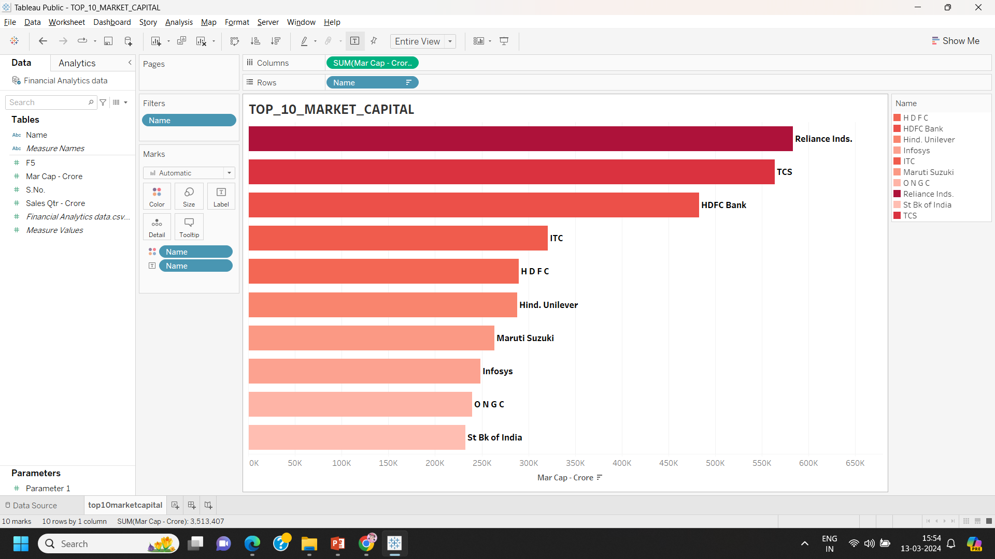

Slide 7
MOCK – UP DASHBOARD
Top_10_quarterly_sales
S no. |  | Name | Mar Cap - Crore | Sales Qtr - Crore
1 |  | I O C L | 178017.48 | 110666.93
2 |  | Reliance Inds. | 583436.72 | 99810.00
3 |  | Tata Motors | 117071.87 | 74156.07
4 |  | B P C L | 98278.00 | 60616.36
5 |  | H P C L | 58034.78 | 57474.25
6 |  | St Bk of India | 232763.33 | 57014.08
7 |  | Rajesh Exports | 23495.54 | 41304.84
8 |  | Tata Steel | 73376.14 | 32464.14
9 |  | TCS | 563709.84 | 30904.00
10 |  | Larsen & Toubro | 180860.74 | 28747.45

Slide 8
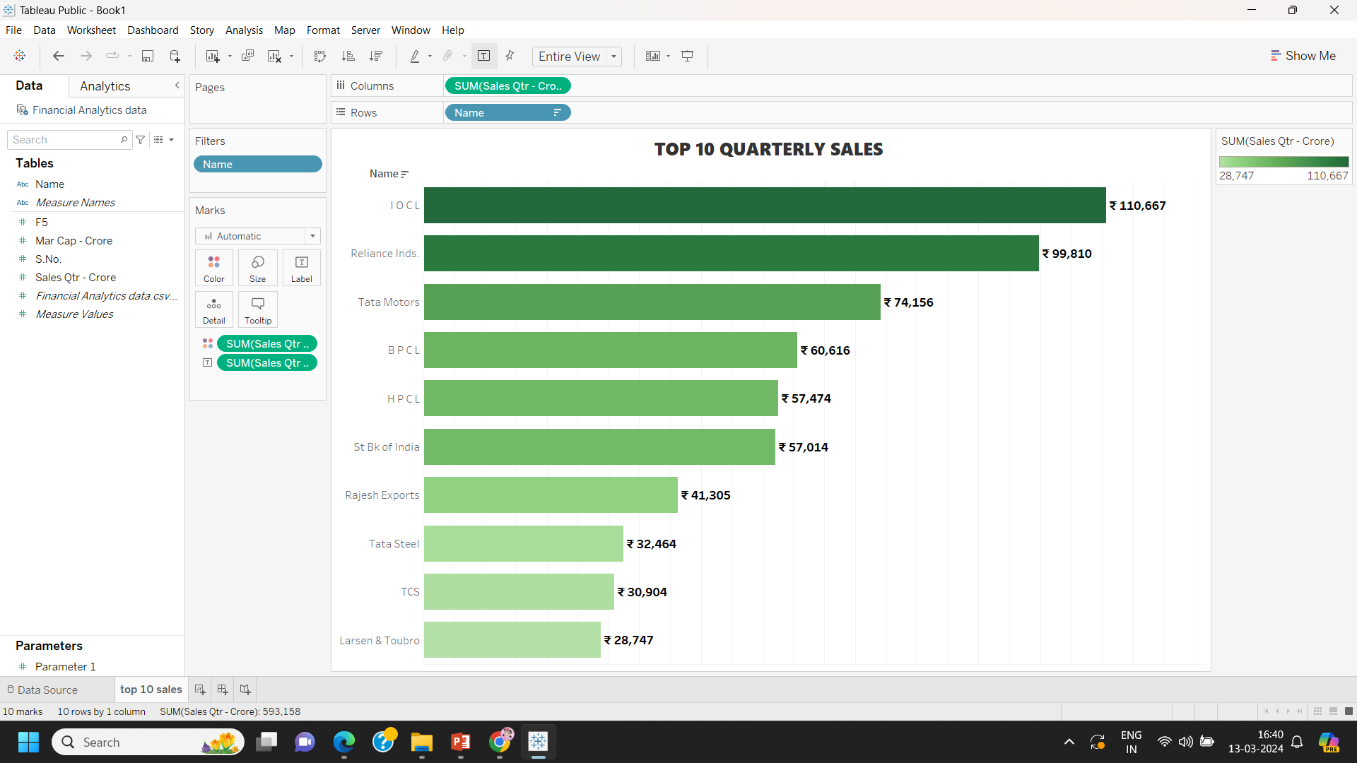

Slide 9
MOCK – UP DASHBOARD
Market Share (%)
S no. | Name | Market share (%)
1 | Reliance Inds. | 16.6
2 | TCS | 16.0
3 | HDFC Bank | 13.7
4 | ITC | 9.1
5 | HDFC | 8.2
6 | Hind. Uniliver | 8.2
7 | Maruti Suzuki | 7.4
8 | Infosys | 7.0
9 | ONGC | 6.8
10 | St Bk of India | 6.6

Slide 10
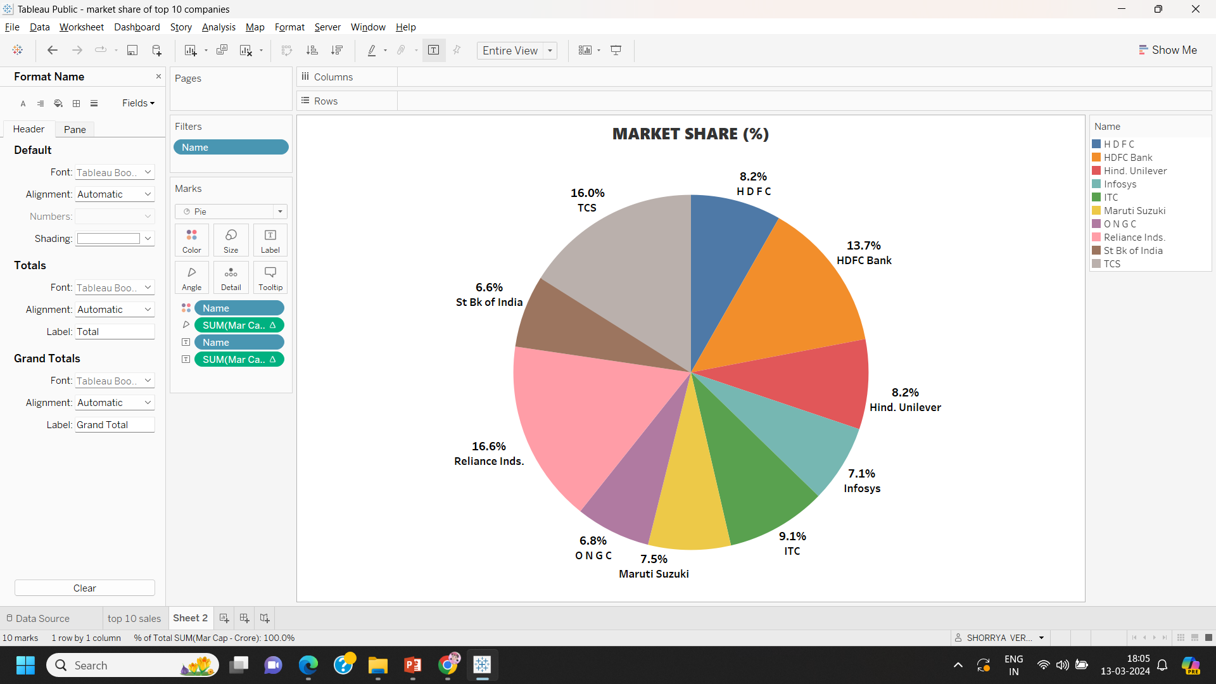

Slide 11
LINKS
Tablue
Github

Slide 12
THANK YOU

